Slide 1
Research Computing Update
September 2020

Slide 2
HPC Resources
KU HPC Cluster
PR for support for h/w is finally completed, 3 months after support period, and 12 months after PR being raised.
New HPC Procurement via ANKABUT
Technical evaluation completed, and in commercial stage.
Procurement halted as there is a lack of assigned funds.
Have contacted VP of Finance to make funds available.

Slide 3
Training
“Research Computing intro session”, “Introduction to Linux”, and “Introduction to HPC” courses are all well attended and well received.
Training calendar is available at https://teamup.com/ksquu2jki56nesnr6n
Due to course being online, places are limited to 5 per session.
All three courses are delivered on a weekly basis.
Developed and delivered two specific Python based courses to a small group of students, as part of a larger AI course being delivered by faculty.

Slide 4
Training Courses

Slide 5
Resource Utilization

Slide 6
KU Cluster core distribution

Slide 7
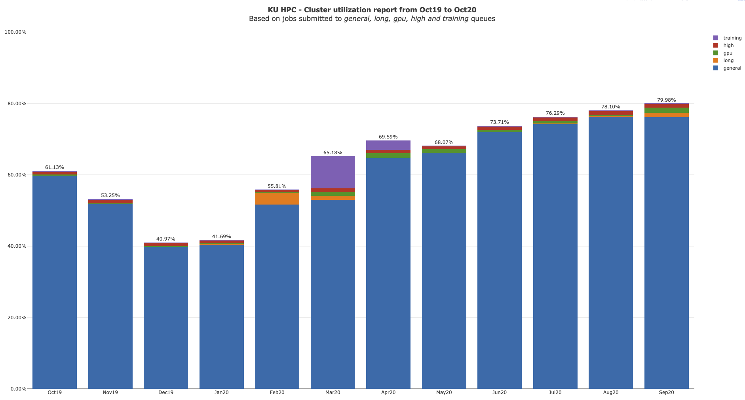

Slide 8
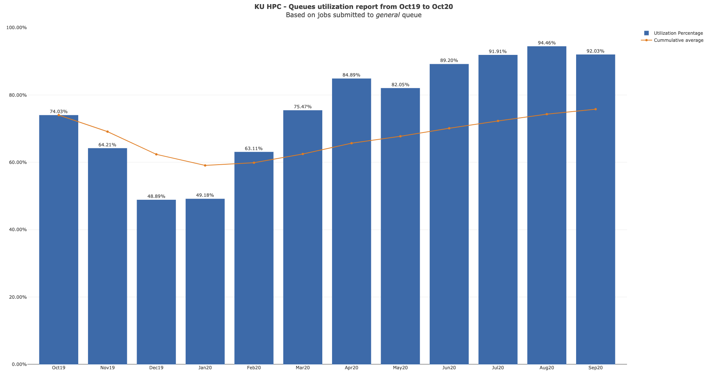

Slide 9
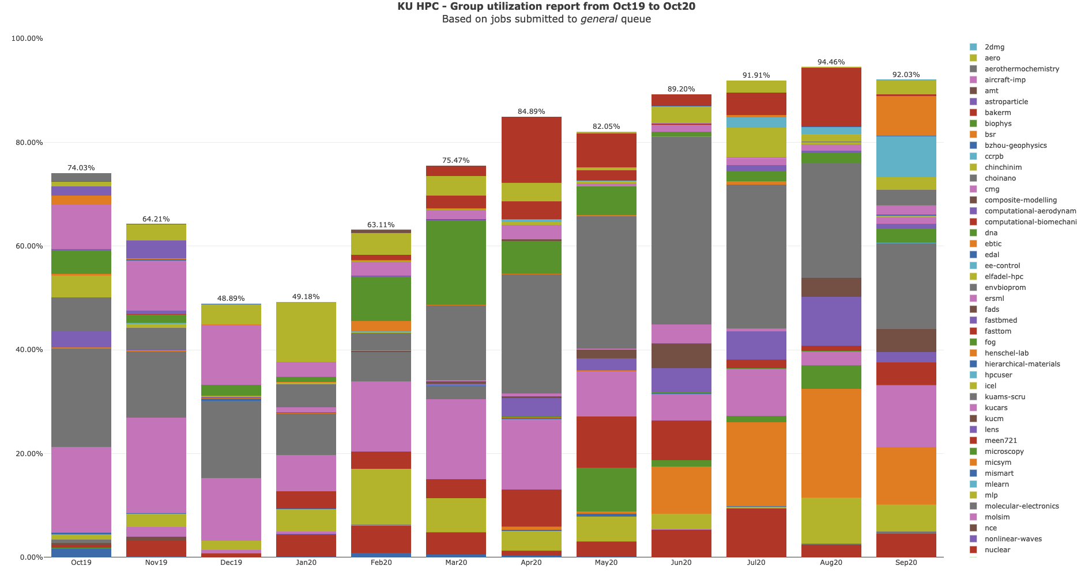

Slide 10
KU HPC Group Utilization for September 2020

Slide 11
PI Cluster core distribution

Slide 12
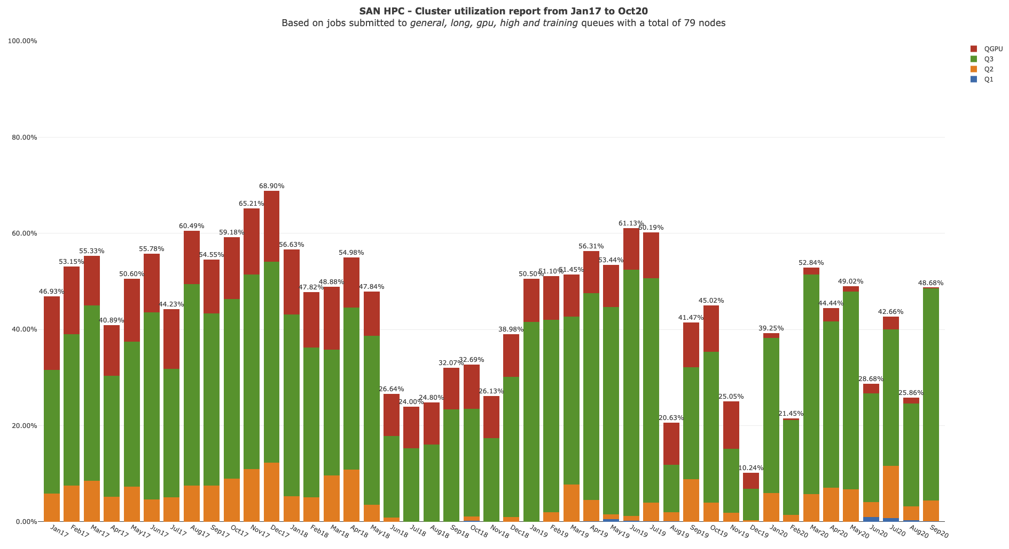

Slide 13
Status of KPI’s

